Slide 1
Deep learning on graphs

Slide 2
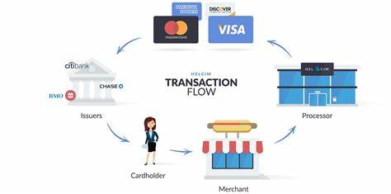
Fraud detection
Detect malicious account
Anti-money laundering
Detect fraudulent medical claim
…

Slide 3
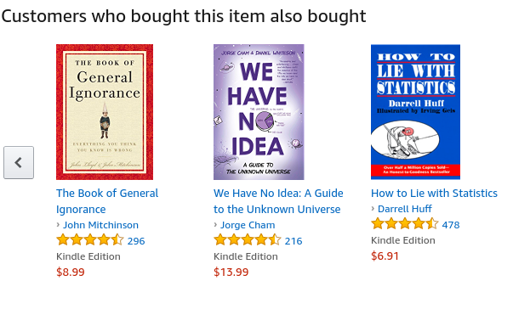
Recommendation

Slide 4

Marketing
Target right customers
Find the influential customers
…

Slide 5
The current approach
Manual feature engineering
Problems of the current approach
Time consuming
Domain knowledge

Slide 6
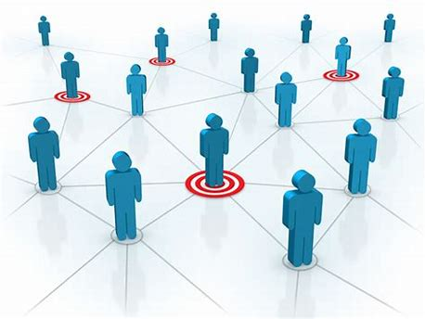
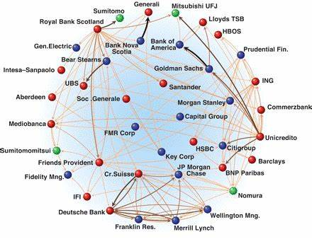
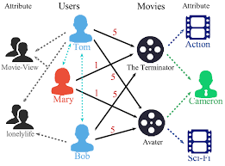
A graph view of the business problems
Marketing with
Social network
Financial Transaction network
Recommender Systems

Slide 7
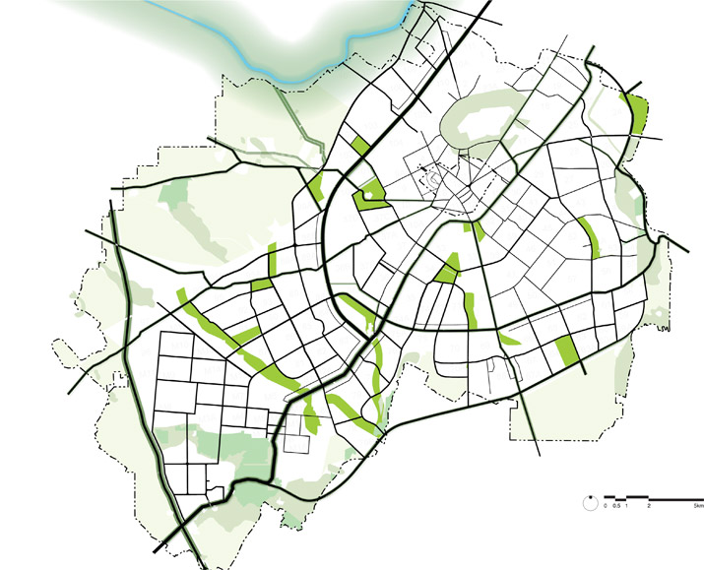
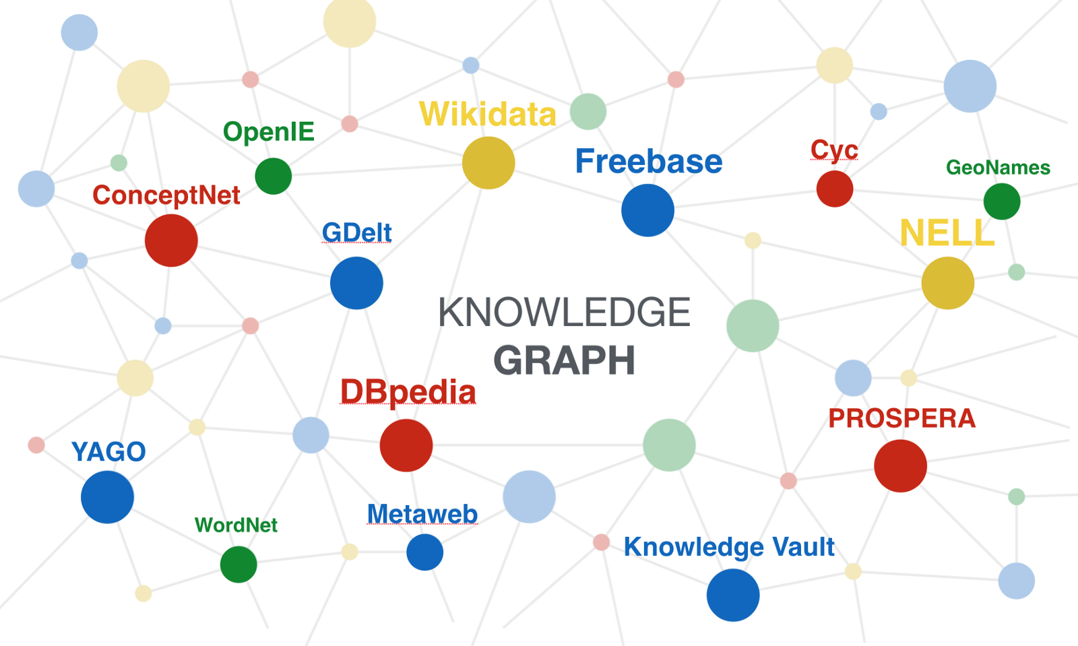
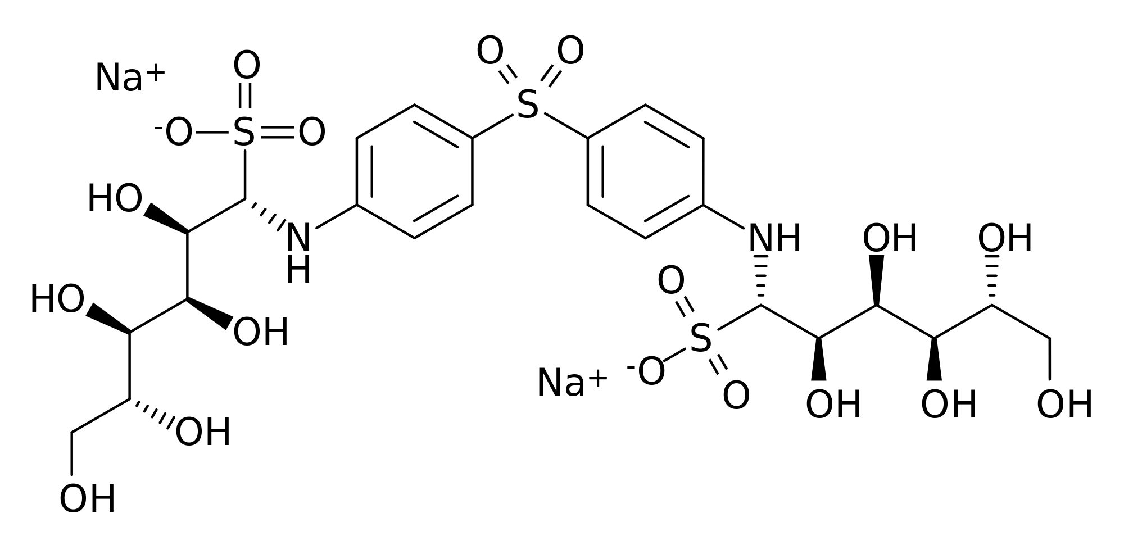
More graph problems
Drug discovery
Knowledge graph
Road network

Slide 8
Tasks in graph learning
Node classification
Detect malicious accounts
Target right customers
Link prediction
Recommendation
Predict missing relations in a knowledge graph
Graph classification
Predict the property of a chemical compound

Slide 9
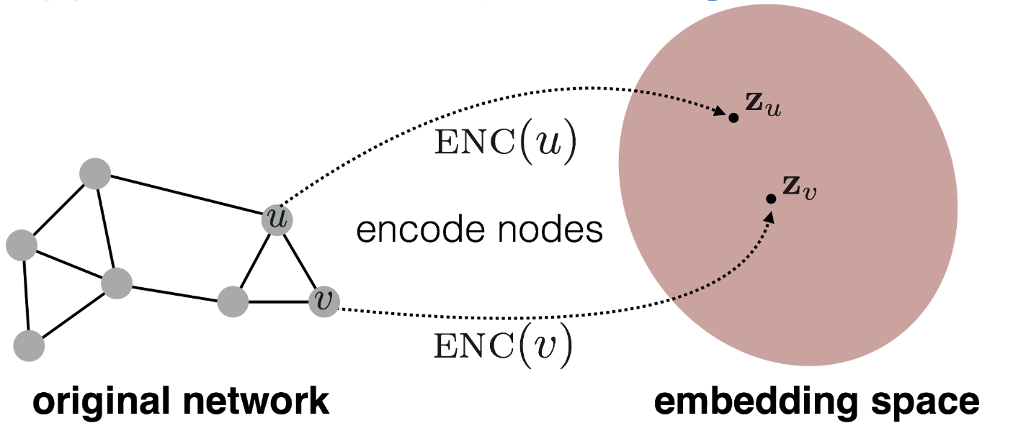
Graph learning requires to embed nodes
Embed nodes to low-dimension space so that similarity in the embedding space approximates similarity in the original graph.
Representation Learning on Networks, snap.stanford.edu/proj/embeddings-www, WWW 2018

Slide 10
What is GNN?
Graph Neural Network (GNN): learn embedding on nodes/edges/graphs
GNN
Classifier

Slide 11
What is new in GNN?
GNN computes node embeddings using both graph structure and node/edge features.
GNN are naturally inductive models because they run the same neural networks on nodes and edges.
GNN and downstream models can be trained in an end-to-end fashion.

Slide 12
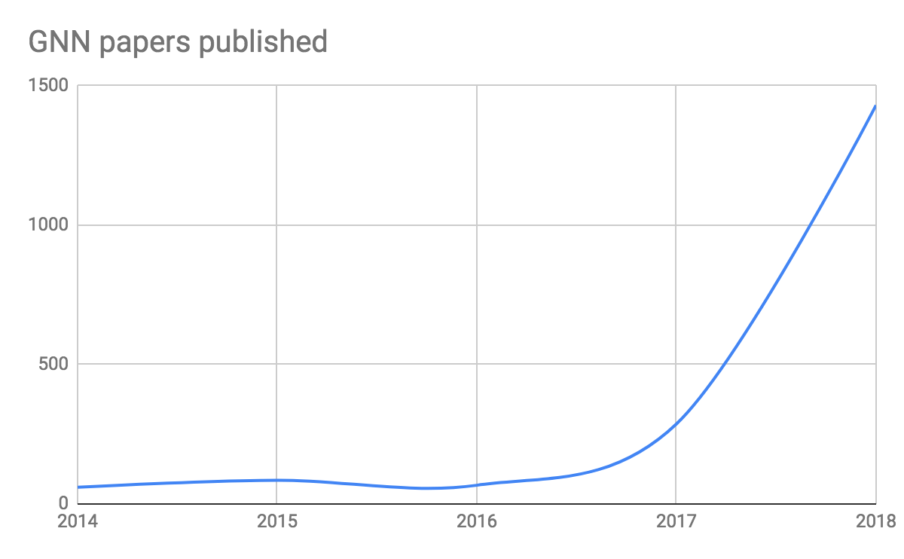
Deep learning + Graph
GNN is emerging as an important class of DL models.

Slide 13
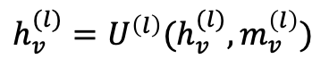
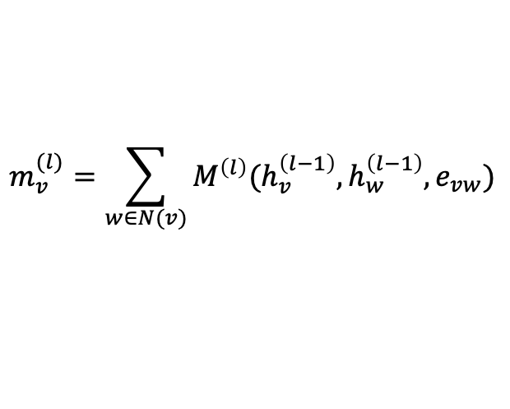
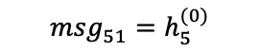
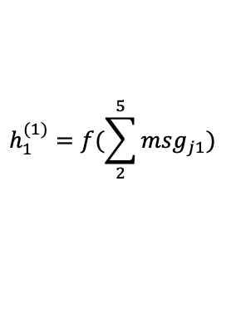
A general formalization of GNN
GNN is based on message passing
Reduce
Message
h₅
h₂
v₅
$$m_{v}^{(l)}=\sum_{w∈N(v)}{M^{\left(l\right)}(h_{v}^{\left(l−1\right)}, h_{w}^{\left(l−1\right)}, e_{vw})}$$
v₂
$${msg}_{51}^{}=h_{5}^{(0)}$$
v₁
$$h_{1}^{(1)}=f(\sum_{2}^{5}{{msg}_{j1}})$$
$$h_{v}^{(l)}=U^{\left(l\right)}(h_{v}^{(l)}, m_{v}^{\left(l\right)})$$
v₃
v₄
h₄
h₃
Neural Message Passing for Quantum Chemistry
Notes:
Message: tensor computed from source node/ destination node/ edge features
Reduce: aggregating the messages (and updating the node representation accordingly)

Slide 14


A GNN Example: Graph convolution network
$M_{vw}^{(l)}$= $\frac{h_{w}^{\left(l−1\right)}}{\sqrt{d_{w}}}$
$$h_{v}^{(l)}=σ(\frac{m_{v}^{\left(l\right)}}{\sqrt{d_{w}}}W^{(l)})$$

Slide 15
More explanation on GCN
Problems:
GCN aggregate all neighbors equally.
It cannot deal with heterogeneous graphs.

Slide 16
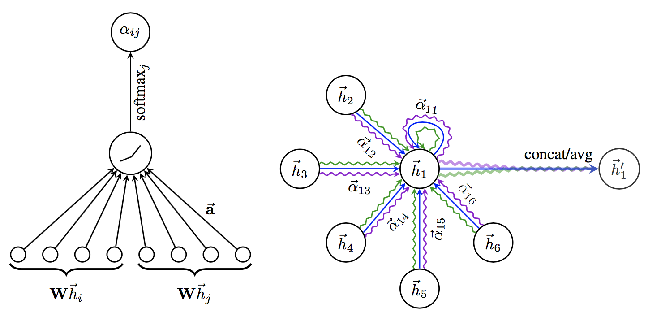
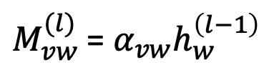
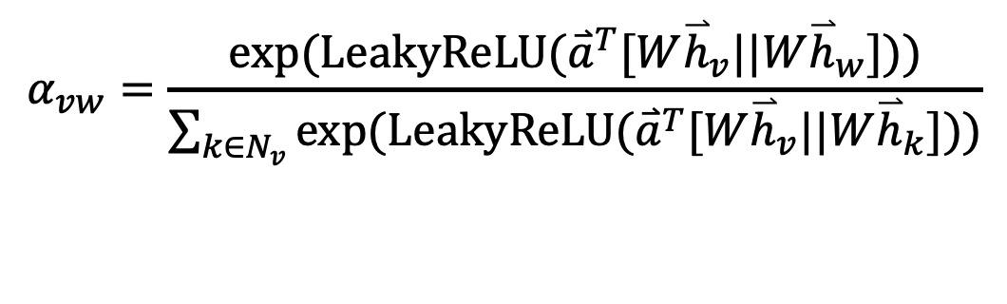
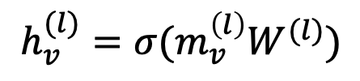
Example 2: Graph attention networks (GAT)
GAT provides weighted sum over the neighborhood.
$M_{vw}^{(l)}$= $α_{vw}h_{w}^{\left(l−1\right)}$
$$h_{v}^{(l)}=σ(m_{v}^{\left(l\right)}W^{(l)})$$
$$α_{vw}=\frac{exp⁡(LeakyReLU({\overset{⃑}{a}}^{T}[W{\overset{⃑}{h}}_{v}||W{\overset{⃑}{h}}_{w}]))}{\sum_{k∈N_{v}}{exp⁡(LeakyReLU({\overset{⃑}{a}}^{T}[W{\overset{⃑}{h}}_{v}||W{\overset{⃑}{h}}_{k}]))}}$$

Slide 17
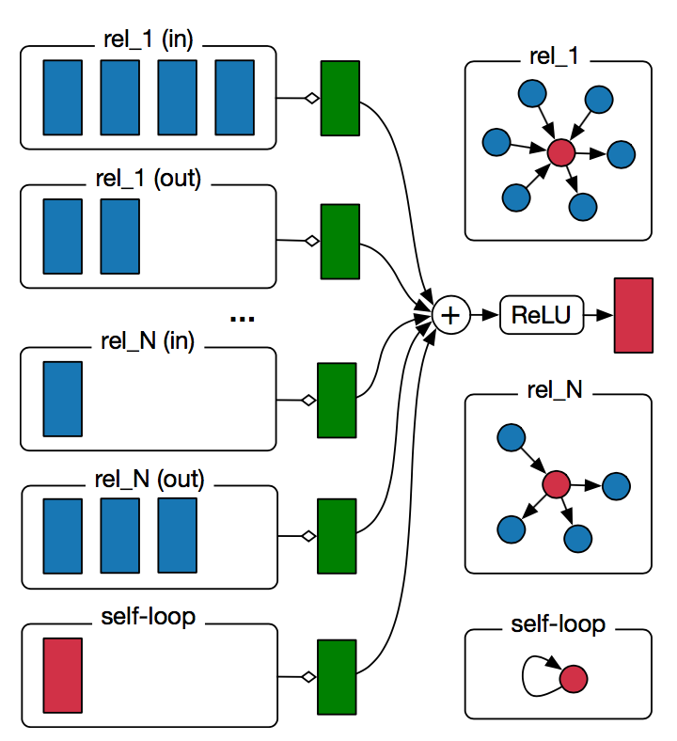
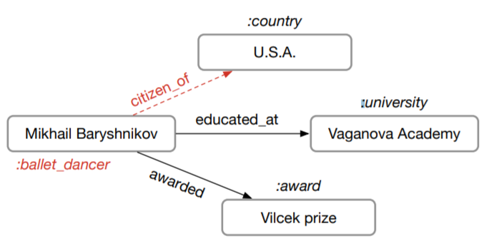
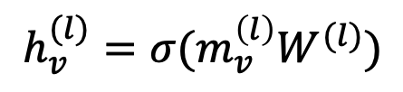
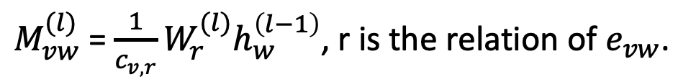
Example 3: Relational graph convolution networks (RGCN)
Handle graphs whose nodes are connected with different relations.
$M_{vw}^{(l)}$= $\frac{1}{c_{v,r}}W_{r}^{(l)}h_{w}^{\left(l−1\right)}$, r is the relation of $e_{vw}$.
$$h_{v}^{(l)}=σ(m_{v}^{\left(l\right)}W^{(l)})$$

Slide 18
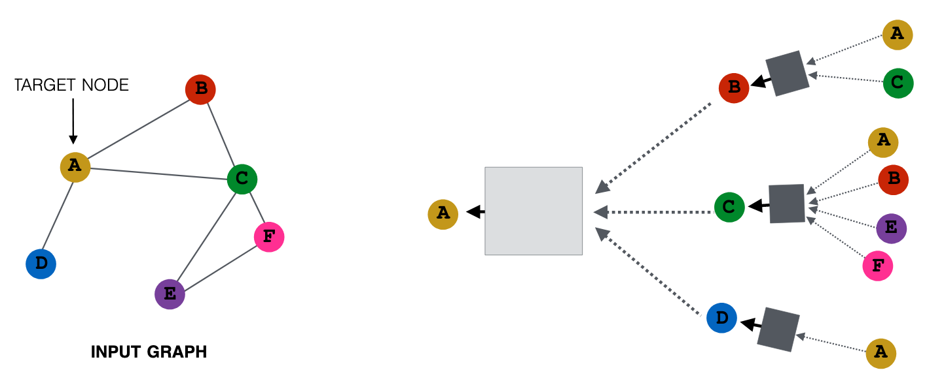
A multi-layer GNN
Multiple GNN layers can be stacked together.
Representation Learning on Networks, snap.stanford.edu/proj/embeddings-www, WWW 2018

Slide 19
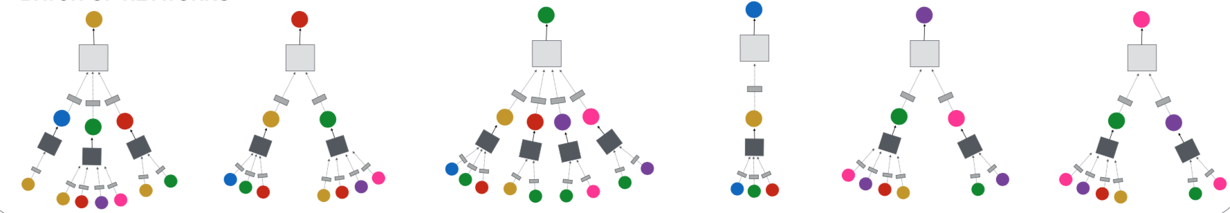
The power of GNN
GNN computes a node embedding based on the node and its local neighborhood.

Slide 20
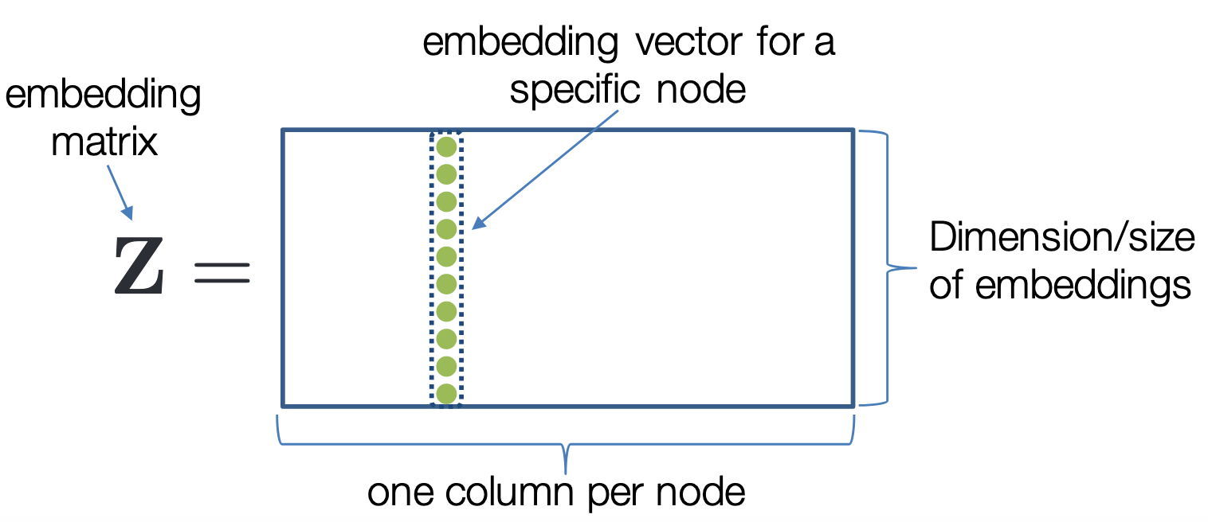
Traditional methods for network embedding
Network embeddings
Matrix factorization
Tensor decomposition
Deep Walk
Autoencoder
…
Traditional methods use embedding matrix to encode.
Representation Learning on Networks, snap.stanford.edu/proj/embeddings-www, WWW 2018

Slide 21
Limitations in traditional methods
Problems:
Traditional methods are all transductive.
Only learn from the graph structure.
Network embeddings cannot be trained with the supervision from the downstream tasks.

Slide 22
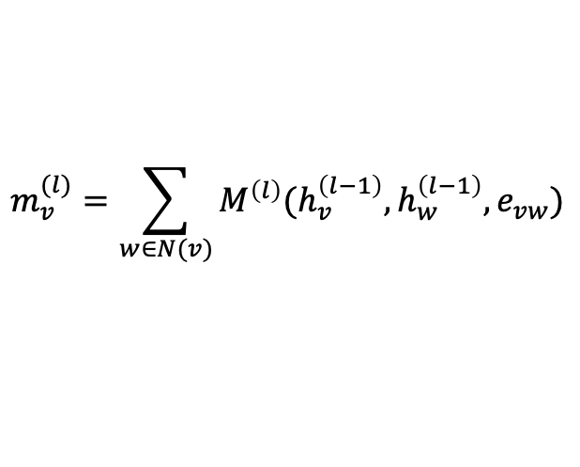

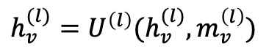
How to train a GNN?
L-layer GNN computes node embeddings
We use $h_{v}^{(l)}$ in a downstream model trained with any loss function.
$$m_{v}^{(l)}=\sum_{w∈N(v)}{M^{\left(l\right)}(h_{v}^{\left(l−1\right)}, h_{w}^{\left(l−1\right)}, e_{vw})}$$
$$h_{v}^{(l)}=U^{\left(l\right)}(h_{v}^{(l)}, m_{v}^{\left(l\right)})$$

Slide 23
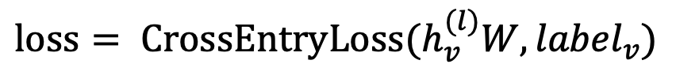
Node classification with GNN
Node classification is trained in the semi-supervised setting.
$$loss= {CrossEntryLoss(h}_{v}^{(l)}W, {label}_{v})$$
0
1
0
?
?
?

Slide 24
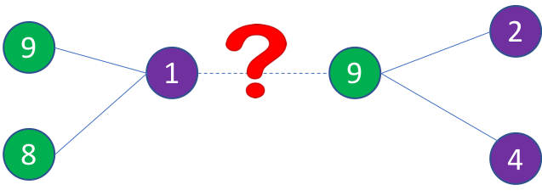

Link prediction with GNN
We can train a link prediction model with connectivity of nodes as the training signal.
Positive edges are trained against a few negative edges
${loss= −log (σ⁡(h}_{v}^{T}h_{w}))−Q∙E_{u_{n}\sim P_{n}(v)}{log (σ⁡(−h}_{v}^{T}h_{u_{n}})$)
Positive edges
Negative edges
Graph convolution to
encode node embeddings
Graph convolution to
encode node embeddings

Slide 25
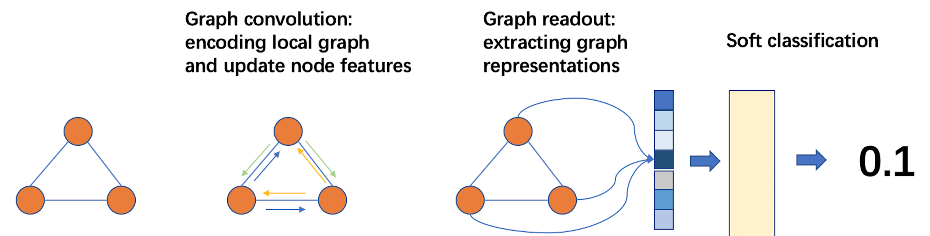
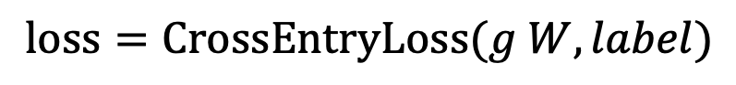

Graph classification
Graph readout to compute graph embeddings
Train a graph classifier on the graph embedding.
$$g=readout\left(h_{1}^{\left(l\right)},h_{2}^{\left(l\right)}, …,h_{n}^{\left(l\right)}\right)$$
$$loss=CrossEntryLoss(g W, label)$$

Slide 26
How to train GNN on large graphs
Many giant graphs at billion scale:
Social networks
Recommendation
Knowledge graph
…
A typical training method: mini-batch training

Slide 27


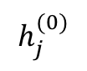
A glance of mini-batch training on graphs
A mini batch represents the computation graph for target nodes.
Small-world graphs lead to a huge computation graph.
2
3
$$h_{1}^{(2)}$$
1
1
10
5
$$h_{i}^{(1)}$$
2
3
4
5
6
9
4
6
8
7
$$h_{j}^{(0)}$$
1
3
4
6
7
8
9
10
11
11

Slide 28
Mini-batch with neighbor sampling
Prune the computation graph:
sample neighbors from a neighbor list of a vertex.
1
1
2
3
4
5
6
2
4
1
7
8
1
3
4
6
7
8
9
10
11

Slide 29
Summary
Many applications can be formulated as graph problems.
Graph neural network is a new technique for graph learning.
GNN has multiple advantages over traditional methods.
We demonstrate how GNNs are used in multiple graph tasks and how these GNN models can be trained.

Slide 30
Thank you!
DGL website: http://dgl.ai
DGL doc: http://doc.dgl.ai

